Slide 1




DIGITAL LITERACY
SKILLS
INTERMEDIATE USERS

Slide 2
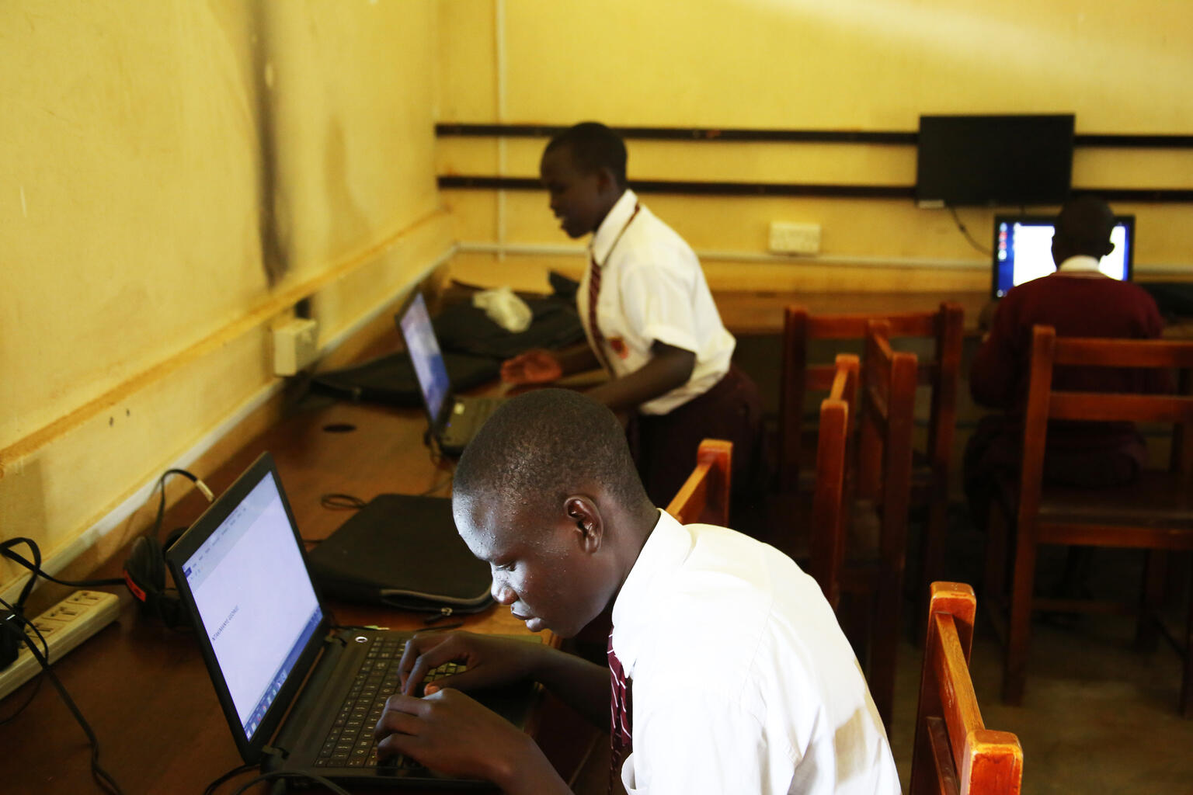
Module 6
Problem solving

Slide 3

4
Unit 4: Identifying digital competence gaps

Slide 4

The digital skills gap
Digital technologies are used in most business and industry sectors.
The demand for information and communications technology specialists is growing fast.
In the future, 9 out of 10 jobs will require digital skills.

Slide 5

Update digital skills
Invest in education
Hit subscribe
Join groups
Get on board with Google Alerts
Head to YouTube

Slide 6
Skills to practise
Update your digital skills
When you use a software or app often, you become aware of the different functions of the software or app that you do not know how to use, for example, how to create a pie chart using Excel.
Search the internet and identify numerous vlogs and websites that discuss functions of the software that you often use.
Bookmark your selected sites and add them to your favourites list.
If it is a vlog, subscribe to the channel so that you receive updates.
Post a question about a problem that you do not know how to solve.
Continue >

Slide 7
Skills to practise
2. Practise your new skill
Identify a tool or function on your device that you need help with.
Search the internet for vlogs or websites that demonstrate how to complete certain functions.
Practise your new skill.

Slide 8
All back covers should include
contact information of the section
producing the work.
© United Nations Children’s Fund (UNICEF) [month and year of publication]

